Slide 1
The after-Life of Stan Lee
Group Members:
Ali, Qasim (Sentiment Analysis)
Hidalgo Trujillo, Roberto (Sentiment Analysis)
Khayrullina, Tatiana (Use-case, Sentiment Analysis, Bag-of-Words)
Lee, Jeongseon (Character Analysis)
Rozko Iwona (Gathered Twitter Data)

Slide 2
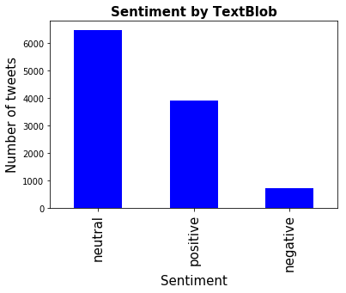
Sentiment analysis –machine made-TextBlob
Neutral: 6482
Positive: 3896
Negative: 726
Total: 11,104

Slide 3
Good data is clean data
Working with tweets in English
Removed punctuation, numbers, stopwords, special characters
Converted to lowercase
Converted sentiment analysis to dummies, used “Positive” only
MultinomialNB matrix accuracy score: 0.63
Gaussian NB matrix accuracy score: 0.36
Working with tweets in English
Removed punctuation, numbers, stopwords, special characters
Converted to lowercase
Used the original Sentiment data
Removed top 30 most frequent words
Removed 2000 least frequent words
Removed all resulting blank rows
MultinomialNB matrix accuracy score: 0.83
Gaussian NB matrix accuracy score: 0.83

Slide 4
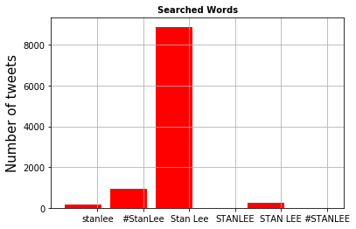
Gathering Data
Tweets collected: 13028
‘stanlee’: 163
‘#StanLee’: 929
'Stan Lee’:8890
'STANLEE’: 3
'STAN LEE’: 249
‘#STANLEE’: 2

Slide 5
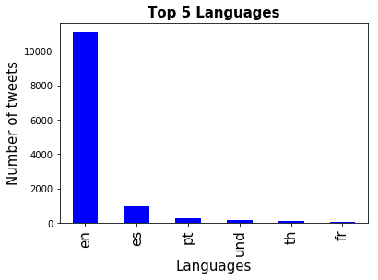
Top 5 Languages
English: 11104
Spanish: 947
Portuguese: 266
no language detected: 163
Thailand: 84
French: 83

Slide 6
Marvel Character Analysis
Which characters are the most mentioned from
"Stan Lee" topic tweets
258 out of 13028 tweets have the marvel characters
Display the number of tweets based on the characters
Display the characters based on languages
"Marvel Character" topic tweets
Total 1399 tweets
Graphs the bag of words based on n-grams(onegram/bigram/fourgram)
How many times Stan Lee mentioned from the marvel character topic tweets
Notes:
This is to compare the two different topic tweets.
One topic is for "Stan Lee" and the other is "marvel character"
Take top 15 common characters from wiki and get relevant tweets which has the top 15 characters in it from "Stan Lee" tweets .
'spider-man', 'x-men', 'hulk', 'ant-man','thor' ,'black widow','black panther','fantastic four', 'daredevil', 'scarlet witch','inhumans','doctor strange', and 'iron man'

Slide 7
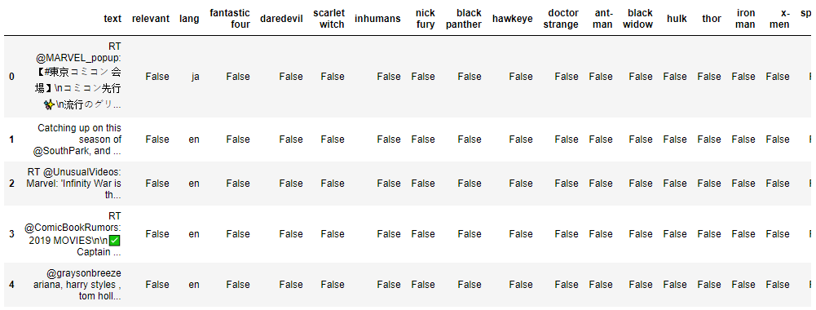
Marvel Character Analysis – Stan Lee
The dataframe has all characters columns
Notes:
Created dataframe to add all required columns.

Slide 8
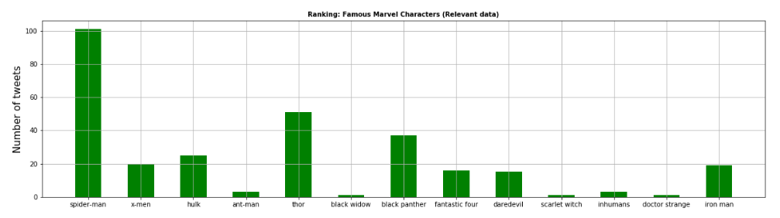
Marvel Character Analysis – Stan Lee
Stan Lee" topic tweets
spider-man: 101, x-men:20, hulk:25, ant-man:3,
thor:51, black widow:1, black panther:37, fantastic four:16,
daredevil:15, scarlet witch:1, injumans:3, doctor strange:1, iron man :19
There is no 'nick fury' and 'hawkeye'
Notes:
Add relevant column to the dataframe to flag whether the individual tweet includes the top 15 character names, set the relevant = true
Get the number of tweets based on the character. 13 out of 15 characters are in the tweets.
258 out of 13028 tweets have the marvel characters and 293 character occurrences in the 258 tweets.

Slide 9
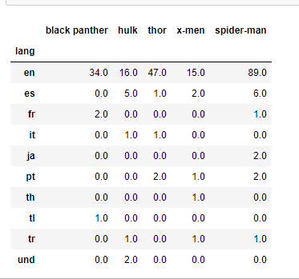
Marvel Character Analysis – Stan Lee
Convert the values to 1 or 0 to count the number of each characters
Remove all other character columns except the ones shown on the right image
The image shows the sum of characters based on each language
Notes:
Previous dataframe has true/false values.
Convert the values to 1 or 0 to count the each characters based on the languages

Slide 10
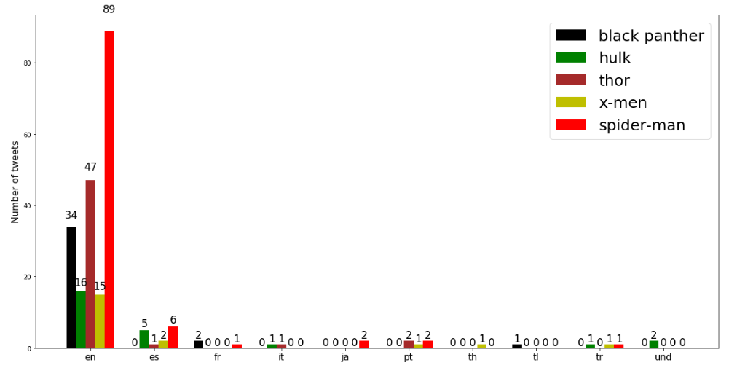
Marvel Character Analysis – Stan Lee
Characters by languages
Notes:
Pick only top 5 characters to display them based on the languages
The most characters are in EN.
En – English, es – Spanish, fr – French, it – Italian, ja - Japanese, Pt – Portuguese, Th – Thai, Tl – Tagalog (Philippines’ second language), Tr – Turkish, Und - Undefined

Slide 11
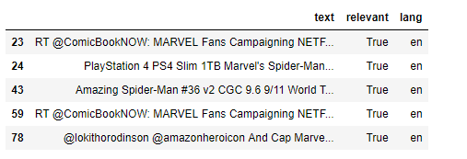
Marvel Character Analysis – Marvel Character
Add required columns to panda dataframe
Get relevant tweets which contains the top 15 characters created by Stan Lee
Counts the tweets
spider-man: 595, x-men: 96, hulk: 113, ant-man: 12, thor: 232, black widow: 17, black panther: 115, fantastic four: 14, daredevil: 141, scarlet witch: 23, inhumans: 2, nick fury: 7, hawkeye: 6, doctor strange: 4, iron man: 57
Notes:
Add relevant column to the dataframe and if any tweets include the top 15 character names, set the relevant = true
1399 tweets are gathered for "marvel character" topic. There are 1434 occurrences of 15 character names.

Slide 12
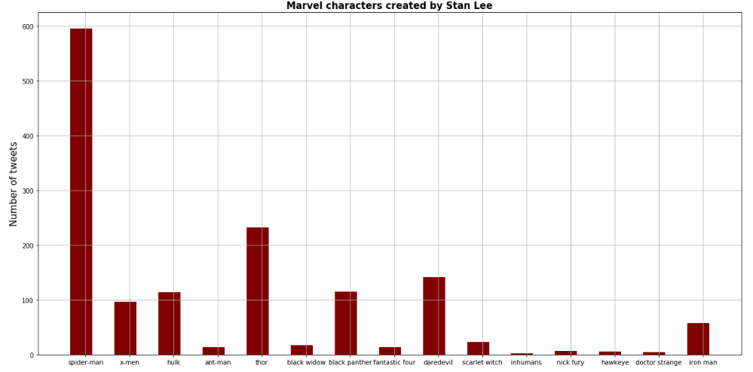
Marvel Character Analysis – Marvel Character
"Marvel character" topic tweets

Slide 13
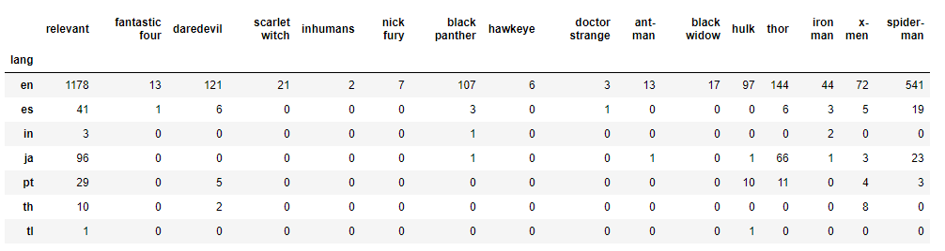
Marvel Character Analysis – Marvel character
It shows the sum of each characters based on the languages
Notes:
Drop all unnecessary fields and update the true/false value to 1/ 0. This is to get the sum of characters based on the languages.

Slide 14
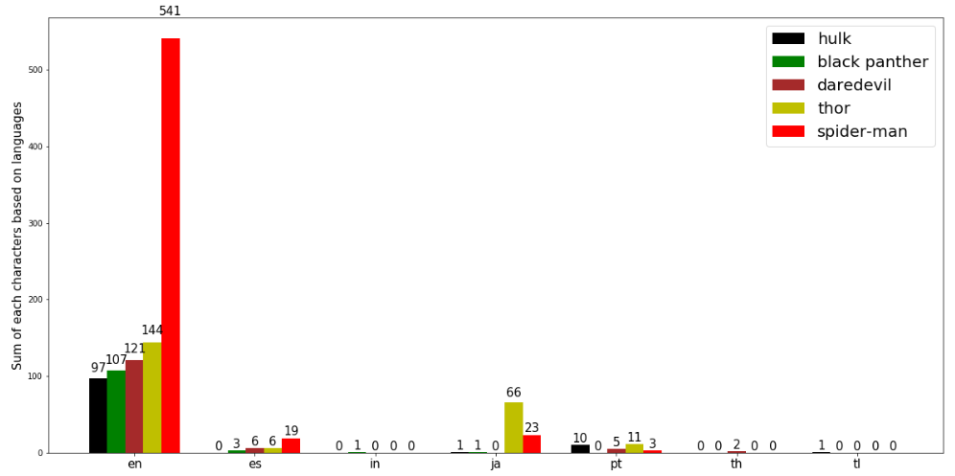
Marvel Character Analysis – Marvel character
Characters by languages
Notes:
Drop all the least language rows and get the top 7 languages
En – English, es – Spanish, in – India, ja - Japanese, Pt – Portuguese, Th – Thai, Tl – Tagalog (Philippines’ second language)

Slide 15
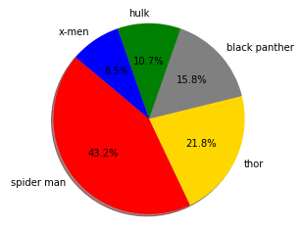
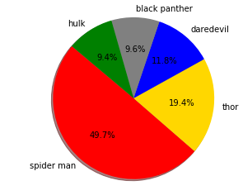
The top 5 Marvel characters in each tweet
Stan Lee topic tweets
Marvel Character topic tweets
Notes:
This shows the top 5 marvel characters in each tweet.
Four characters are the same except x-men and daredevil.

Slide 16
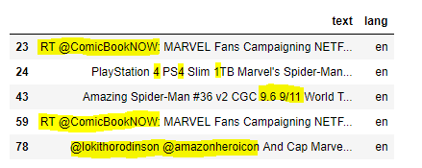
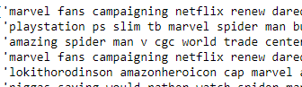
Marvel Character Analysis – Marvel character
Create bag of words
Remove URLs, punctuation, 'RT', numbers and username
Remove stop words
Notes:
Clean data to create bag of words

Slide 17
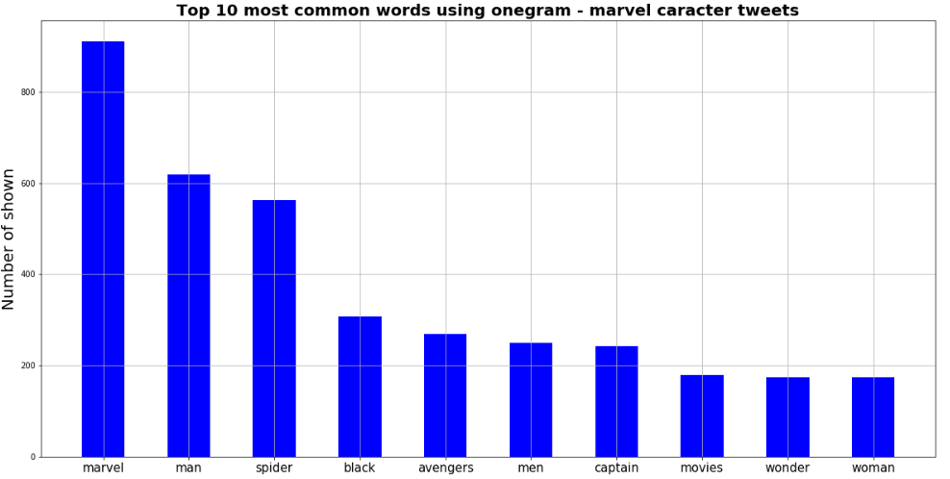
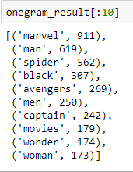
Marvel Character Analysis – Marvel character
One-gram
Notes:
The bag of word saved a dictionary(key:value)
Sorted the dictionary and save to a list.
The left image shows the top 10 words

Slide 18
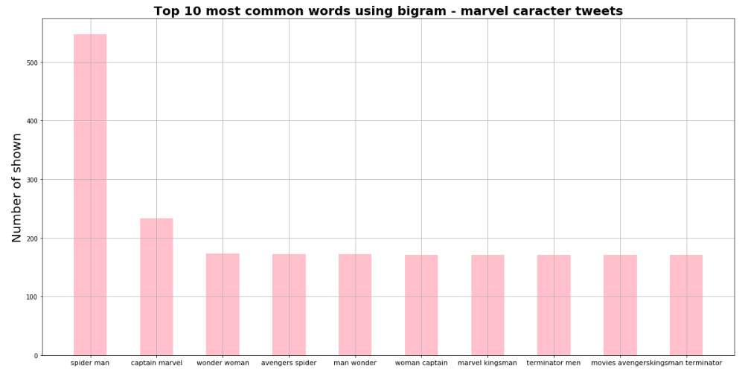
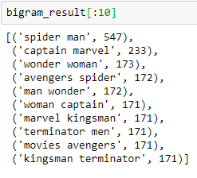
Marvel Character Analysis – Marvel character
bi-gram
Notes:
This is bi-gram. The steps are the same with one-gram, but it has two words for the key.
The image shows sorted result

Slide 19
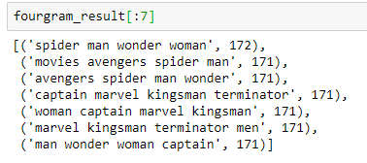
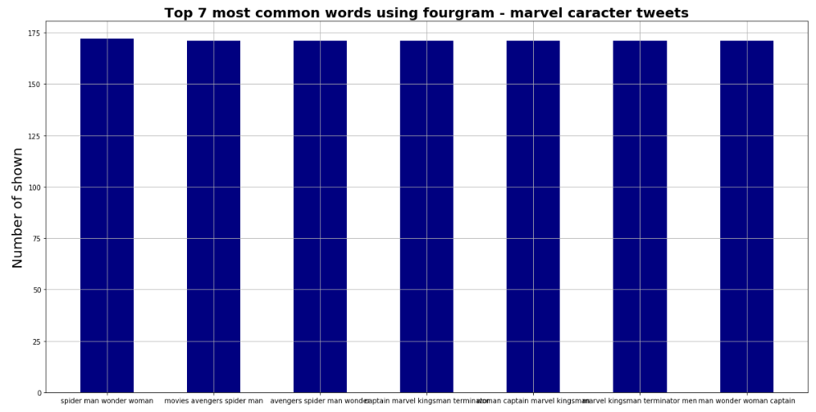
Marvel Character Analysis – Marvel character
four-gram
Notes:
Four-gram result
This doesn't mean a lot since all search character is one or two words.
Onegram and bigram have correct character word(s). So that shows exactly how many occurrences in the tweets.

Slide 20
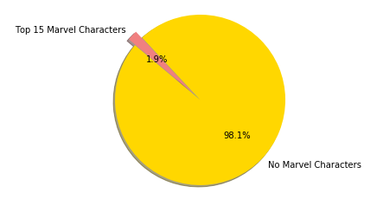
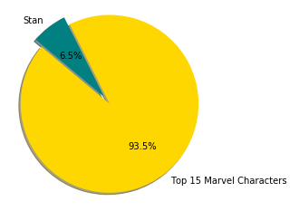
Marvel Characters in Stan Lee topic tweets vs Stan in Marvel character topic tweet
Stan Lee topic tweets
Marvel Character topic tweets
Notes:
This shows how many tweets mentioned marvel characters in stan lee topic tweets and how many tweets mentioned Stan in the marvel character topic tweets.
From this result, the marvel characters topic tweets have more 'stan' than stan lee topic tweets have marvel characters.

Slide 21
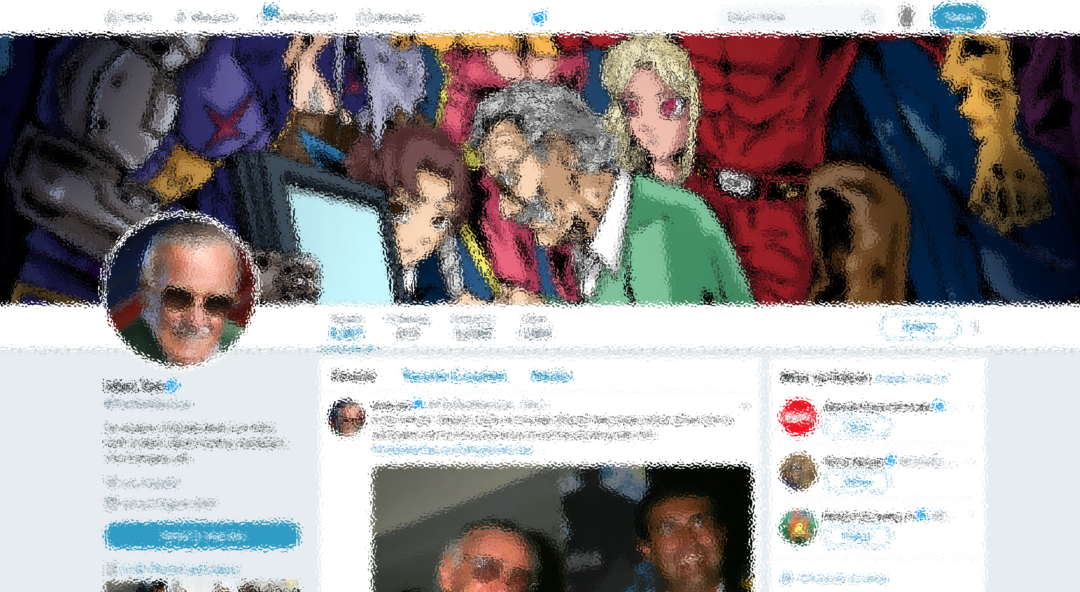
Sentiment Analysis
Manual sentiments for training dataset
Three categories:
Positive tweets
Negative tweets
Neutral tweets
Notes:
This shows how many tweets mentioned marvel characters in stan lee topic tweets and how many tweets mentioned Stan in the marvel character topic tweets.
From this result, the marvel characters topic tweets have more 'stan' than stan lee topic tweets have marvel characters.

Slide 22
Sentiment Analysis
Notes:
This shows how many tweets mentioned marvel characters in stan lee topic tweets and how many tweets mentioned Stan in the marvel character topic tweets.
From this result, the marvel characters topic tweets have more 'stan' than stan lee topic tweets have marvel characters.

